Slide 1


CONTROL STORE TESTING USING Causal Impact
Updated February 2019

Slide 2


WHY DO WE TEST?
TESTING IS USED TO GAIN STATISTICALLY SIGNIFICANT INSIGHT ON IN-STORE CHANGES
“I need to understand the impact of a test on my brand/category”
“I want to understand how a test impacts key performance metrics”
“I’m trying to make a ‘go/no-go’ decision and need to understand ROI”

Slide 3

TESTS MEASURE THE IMPACT OF IN-STORE CHANGES
Examples of changes include:
Aisle redesign
Assortment changes
Packaging innovation
In-store marketing
Price changes and promotions

Slide 4
OUR 2 CONTROL STORE TESTING PROCESSES, CAUSAL IMPACT AND ANCOVA (CST), ARE FAIRLY SIMILAR
Both have test stores and compare them against a group of Control stores
Both deliverables give us uplift numbers as well as statistical significance levels to draw test conclusions
Both match with pre-period data (Causal uses 156 weeks, ANCOVA (CST) uses 52 weeks) to find a control

Slide 5
AS A DATA SCIENCE COMPANY WE ARE MOVING TO CAUSAL IMPACT FOR TESTS
It is a growing methodology at top tech companies for measurement
More data points in pre and test period leading to more precise measurement
84.51° completed internal validation which concluded that Causal Impact out-performs ANCOVA (CST) in most cases:
It is more flexible to different size tests
It has higher levels of accuracy
It has a decreased cost (fewer stores) of conducting a test from a operational standpoint

Slide 6
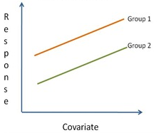
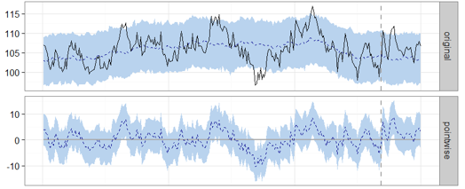
THERE ARE TWO WAYS TO PERFORM A CONTROL STORE TEST
ANCOVA (CST)
CAUSAL IMPACT

Slide 7
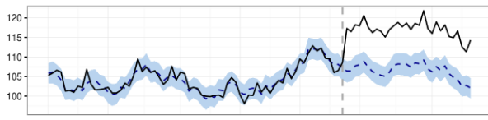
CAUSAL IMPACT ALLOWS FOR MULTIPLE CONTROLS PER TEST STORE AND PLACES HIGHER IMPORTANCE ON STRONGER MATCHED STORES
CREATE A CONTROL
GENERATE A FORECAST
1
2
from weighted combinations of individual control store metrics over time for Each Product Group and Metric and the observed trend effect of the test stores.
using the synthetic control, created for Each Product Group and Metric which tells us what would have been observed in the test stores, after the test implementation, in the absence of treatment.
COMPARE TO TEST
3
Observing the forecasted results versus the actual performance of the test stores identifies the estimated impact of the test.
Pre-Period
Test Period

Slide 8
CAUSAL IMPACT SELECTS CONTROL STORES
Control Store 3
Control Store 2
Control Store 1
For each Product Group, Causal Impact filters and weights potential control stores based on how they correlate with the test stores in the pre-period.
This filter allows us to include a large number of potential control stores in a test.
Control Store 3
Control Store 1

Slide 9
WHEN MEASURING WITH ANCOVA (CST), EVERY TEST STORE IS PAIRED WITH A SINGLE CONTROL STORE
Stores are typically matched based on a number of metrics:
Control
Test
Shopper-based:
spend, units, visits, HHs, HH penetration
derived metrics (e.g. units/HH)
total shoppers and shopper segments
Store level:
total store sales, household counts
store dimensions, total store MyLife profiles, store characteristics

Slide 10
LET’S EXAMINE THE DIFFERENCES THROUGH AN EXAMPLE OF MATCHING 1 TEST STORE
Test Facts
5 Possible Control Stores
3 Product Groups (Product Group A, B and C)
Test
Control
1
1
2
3
4
5
Product Groups
A
B
C
Central Problem: How to pick Control Stores?

Slide 11
THIS IS HOW ANCOVA (CST) CREATES A CONTROL: PICK ONE CONTROL STORE PER TEST STORE THAT IS THE BEST OVERALL MATCH
1
1
2
3
4
5
A
✓
✓
Test Store 2 is mapped to Control Store 4
B
✓
✓
Product Groups
C
✓
✓
The matching method forces a one size fits all store match
Product Group C has 2 stores (Control 1 and 5) that are much better fits, but a CST does not use them at all in the measurement

Slide 12
CAUSAL IMPACT TAKES A DIFFERENT APPROACH: EACH PRODUCT GROUP GETS ITS OWN GROUP OF CONTROL STORES
1
1
2
3
4
5
A
✓
✓
2
4
A
=
&
✓
✓
3
4
B
B
=
&
Product Groups
C
✓
✓
1
5
C
=
&
The Causal Impact matching process in contrast allows for more flexibility.
Each Control Store is weighted based on how strong its relation is to the Test store(s). For example, for Product Group A, Control 2 may be 60% and Control 4 may be 40% because Control 2 is a much stronger match then Control 4

Slide 13
APPENDIX

Slide 14
ANCOVA (CST) IS GROUNDED IN ANALYSIS OF COVARIANCE, USED FOR ESTIMATING THE INCREMENTAL EFFECT OF A TEST
Unadjusted Test Store Sales
Actual (Adjusted) Post Period Lift
Existing difference between Test and Control Store Groups
Unadjusted Control Store Sales
Match (Pre) Period
Test (Post) Period
ANCOVA (CST) can control for differences between the test and control stores during their pre and test periods, allowing us to isolate the effect of the test

Slide 15
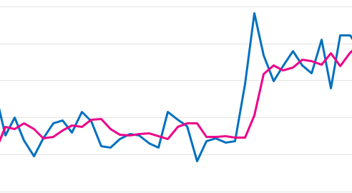
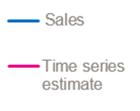
CAUSAL IMPACT IS GROUNDED IN A BAYESIAN STRUCTURAL TIME SERIES (BSTS) MODEL
BSTS models can account for
Local trends
Seasonal effects
Regression effects
These components allow an efficient use of our data, enabling a powerful test even when run on a small sample of stores

Slide 16
THE CAUSAL IMPACT SOLUTION ACCOMMODATES FOR A VARIETY OF TESTING SCENARIOS
WHAT IS THE CONFIDENCE LEVEL, AND WHAT DOES IT MEAN TO BE 90% CONFIDENT?
Multiple test cells
Custom store and product groups
Blackout periods
Pulling data by week or by 4-week time periods
Choosing measurement metrics
Specifying entire product commodities rather than providing a UPC list
Choosing total test and control divisions for full-division rollouts

Slide 17
Causal Impact - Frequently Asked Questions
WHAT IS THE SYNTHETIC CONTROL, AND HOW IS IT CREATED?
The synthetic control is a weighted combination of stores that did not receive the test. For each metric and product group, a weighted combination of control stores is chosen algorithmically based on how closely it fits the test stores in the pre-period. The post-period data for this synthetic control is then used to predict what would have happened in the test stores had the test not taken place. Our methodology has checks in place to ensure that stores with incomplete or missing data – such as new stores – are excluded from the model entirely, and we can also manually exclude stores if we know they are showing unusual behavior, such as a recent remodel.

Slide 18
Causal Impact - Frequently Asked Questions
WHY DON’T THE INDIVIDUAL PRODUCT GROUP UPLIFTS ADD UP TO THE TOTAL?
Unlike ANCOVA (CST), Causal Impact does not designate specific control stores individually. Causal Impact will generate synthetic controls that match test stores for every metric. These metrics are run independent of each other and are each based on different synthetic controls, so they’re not directly comparable. With this method, we can be more certain that uplifts seen are true versus the rest of the division, rather than due to our choice of control stores.

Slide 19
Causal Impact - Frequently Asked Questions
WHAT IS THE CONFIDENCE LEVEL, AND WHAT DOES IT MEAN TO BE 90% CONFIDENT?
The confidence level is the probability, based on the obtained data, that the test had an impact for that product group + metric. In other words, if the confidence level of a metric is 90%, then we are claiming that there is 90% probability that the test had an impact (that the uplift was not zero). We say that a metric is “significant” if our confidence is 90% or higher, and “directional” if our confidence is 80% or higher.

